Slide 1
Azure Storage Account

Slide 2
Azure Storage Account
Azure Storage Account Overview
Storage Replication
Storage Types
Access Tier
Networking
Backup
Encryption
Tools to Access the Storage Account
Data Management features
Best Practices

Slide 3
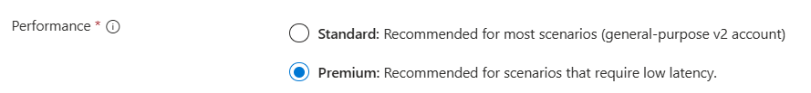
Azure Storage Account
Introduction to Azure Storage Account
Azure Storage is a Microsoft-managed service providing cloud storage that is highly available, secure, durable, scalable, and redundant.
Premium Will support LRS and ZRS only
Standard Will Support LRS,ZRS,GRS,GZRS

Slide 4
Storage Replication types
3️⃣ GRS – Geo-Redundant Storage
Total Copies: 6
Breakdown:
3 copies in primary region (LRS)
3 copies in secondary region (LRS)
Replication to secondary region is asynchronous
4️⃣ GZRS – Geo-Zone Redundant Storage
Total Copies: 6
Breakdown:
3 copies in primary region (ZRS → across 3 zones)
3 copies in secondary region (LRS)
This is the highest durability storage option in Azure.
1️⃣ LRS – Locally Redundant Storage
Total Copies: 3
All 3 copies stored within a single datacenter
Synchronous replication
2️⃣ ZRS – Zone Redundant Storage
Total Copies: 3
Stored across 3 different Availability Zones
One copy in each zone
Protects from zone failure
MS SLA for Data Availability
LRS provides at least 99.999999999% (11 9s)
ZRS provides at least 99.9999999999% (12 9s)
GRS provides at least 99.99999999999999% (16 9s)
GZRS provides at least 99.99999999999999% (16 9s)

Slide 5
Azure Storage Account
Storage Services & Use Cases
Blob Storage : Unstructured data (images, videos, backups).
File Storage : SMB and NFS file shares.
Queue Storage : Messaging between components.
Table Storage : NoSQL key-value store.
Disk Storage : Managed disks for VMs
Type | Use Case
Block Blob | Images, documents, large files
Append Blob | Logs, append-only workloads
Page Blob | Virtual machine disks (VHD)

Slide 6
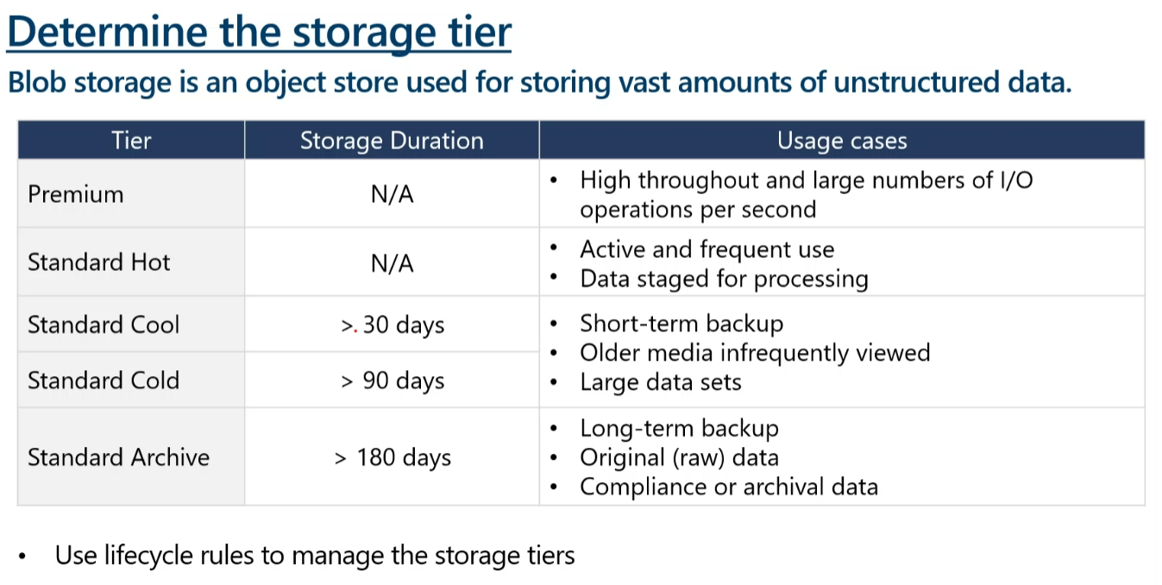
Azure Storage Account
Hot = Pay more to store, less to read.
Cool = Pay less to store, more to read.
Archive = Pay very little to store, but expensive and slow to read.

Slide 7
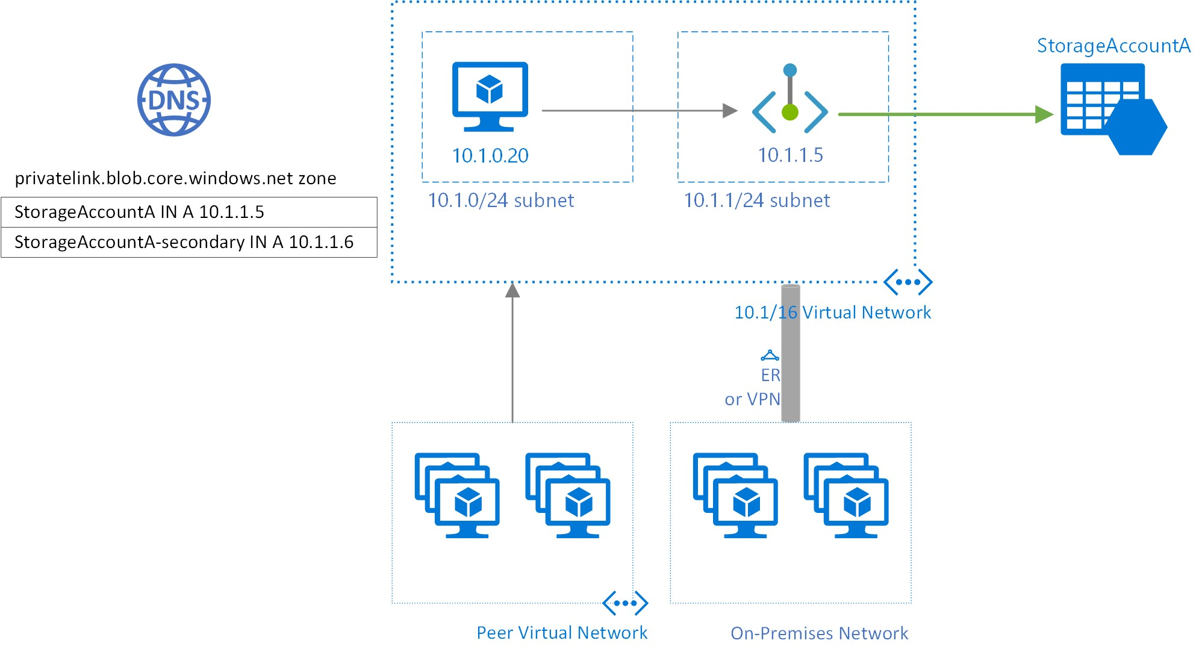
Azure Storage Account
Storageacc.privatelink.blob.core.windows.net
Storageacc.blob.core.windows.net
Storage Account Networking
All networks → public, open
Selected networks → restricted public, medium security
Private Endpoint → fully private, highest security
DNS is important for PE
Cross-region access → supported with VNet Peering + Private DNS
Storage Account Encryption
Encryption at Rest(Server Side Encryption SSE)
Encryption in Transit (HTTPS/TLS)

Slide 8
Azure Storage Account
✅ Tools to Access Storage
Show demos for these tools:
Azure Portal
Azure Storage Explorer
AzCopy (High-performance CLI for Blob & File Share transfers)
Azure CLI (az storage blob upload)
PowerShell (Set-AzStorageBlobContent)
Terraform resources (azurerm_storage_account, azurerm_storage_container)

Slide 9
Data Management features
6. Data Encryption (At Rest & In Transit)
All data is encrypted using AES-256 by default.
Supports customer-managed keys (CMK) in Key Vault
7. Network Security
Private Endpoints, Firewalls, VNET integration.
Restrict access to only trusted networks.
8. SAS Tokens (Shared Access Signatures)
Granular, time-bound access to specific containers/blobs.
No need to share account keys.
9. Cross-Region Replication (GRS/GZRS)
Automatic replication to a secondary region.
Provides disaster recovery readiness.
10. ADLS Gen2 (Hierarchical Namespace)
Optimized for big data analytics.
11. Static Website Hosting
Host static HTML/JS/CSS files directly in Blob Storage.
Simple and cost-effective website solution.
12.Access Key
1. Lifecycle Management
Automates moving data between Hot, Cool, and Archive tiers.
Helps reduce cost by deleting or tiering old data.
2. Versioning
Maintains previous versions of blobs.
Allows recovery from accidental overwrite or changes.
3. Soft Delete (Blob / File / Container)
Retains deleted data for a chosen period.
Protects against accidental deletion.
4. Immutable Storage (WORM)
Write-Once-Read-Many protection.
Prevents data from being changed or deleted for compliance.(Time based retain,Legal-Hold)
5. Change Feed
Tracks all create, update, delete events in a blob.
Used for auditing, analytics pipelines, and event-driven apps.

Slide 10
Azure Storage Account
Best Practices (Enterprise Ready)
Security
  Use Private Endpoints
  Disable public access
  Use RBAC + AAD
  Avoid long-lived SAS tokens
Performance
  Use Premium storage for high IOPS workloads
  Use correct tier (hot/cool/archive)
Cost Optimization
  Lifecycle management rules
  Avoid unnecessary redundancy (GRS if needed)
  Monitor unused blobs/file shares
Operations
  Enable soft delete
  Enable versioning
  Centralized logging

